Slide 1

 | S.S.V.P.S’s B. S. Deore Polytechnic, Dhule Department of Computer Engineering Academic Year : 2026-2027
SEMINAR AND PROJECT INITIATION COURSE
Sem : CO 5 K |  | SPI – 315003 | Date : 17/10/2026
Topic : Smart Inventory Management System using IoT and AI/ML
Roll No. |  | Name of Student
83 |  | Shaikh Mohammad Zakariya Haffizuddin
84 |  | Shaikh Suher Rayaz
85 |  | Sharma Nilesh Ashok
112 |  | Ansari Zeeshan Habib

Slide 2
Contents
Certificate
Abstract
Introduction
Literature Review
Information to Seminar Topic
Advantages and Disadvantages
Conclusion
Project Initiation :
6.1 Description of problem statement
6.2 Scope and objectives
6.3 Stakeholders
6.4 Seminar execution plan
6.5 Platform / Equipment / Resources identification
Bibliography
References

Slide 3
Abstract
Inventory management in most organizations, from large warehouses to small shops and college laboratories, still depends on manual registers, physical counting and guesswork, which causes stock-outs, over-stocking, wastage and lost equipment [4]. This seminar reviews eleven research papers on IoT- and AI/ML-based inventory management, from large supply chains down to a single laboratory [1]–[11]. The papers show that RFID and sensor-based tracking improve stock accuracy, and that models such as Random Forest give reliable demand forecasts [5], [7]. Based on this survey, we propose a low-cost Smart Inventory Management System for a college department or small store using an ESP32, RFID and load-cell sensors, a Flask–MySQL backend, a Random Forest forecasting model and a web dashboard with automatic low-stock alerts [8], [11].

Slide 4
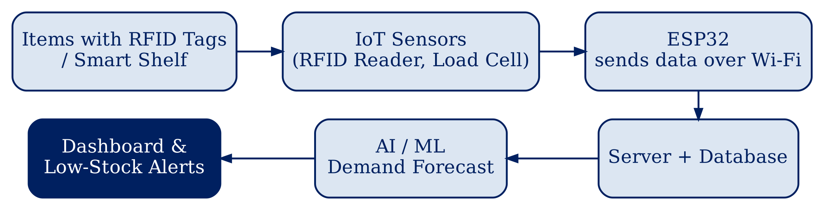
1. Introduction
The term “Internet of Things” was coined by Kevin Ashton in 1999 at Procter & Gamble, after a popular lipstick kept missing from shelves though records showed it was in stock [12], [13].
His main goal: tag products with RFID so that computers gather data on their own, instead of people entering it by hand [12], [13].
Manual registers and counting are slow and error-prone, causing stock-outs and over-stocking [4], [10].
IoT devices (RFID readers, weight sensors) track stock automatically in real time [5], [9].
AI/ML models learn from past usage to forecast future demand [3], [7].
Together they give automatic, data-driven inventory with low-stock alerts [8].
Fig 1: Working of Smart Inventory Management System [7], [8], [9]

Slide 5
2. Literature Survey
Sr. No. | Approach Type | Technologies Used | Dataset | Key Objective | Limitations
[1] | Supply-chain demand forecasting (RBRO-WRF) | IoT sensors, Weighted Random Forest, Python | Kaggle supply-chain data | Accurate demand prediction for logistics | Overfitting risk; high compute; not generalized.
[2] | Review of AI + IoT in inventory | AI, IoT, edge computing, blockchain | None (literature review) | Future view of smart inventory | No implementation or experiments.
[3] | Big Data + IoT review, food industry | LR, KNN, Decision Tree, XGBoost, Random Forest | Sales of top food items | Reduce over/under-stocking of food | Single sector; cost for small outlets.

Slide 6
Sr. No. | Approach Type | Technologies Used | Dataset | Key Objective | Limitations
[4] | AI-driven IoT framework for retail | RFID, smart shelves, cloud, ML | Public and synthetic data | Real-time tracking and forecasting | Conceptual; security and scalability open.
[5] | IoT + WSN with ensemble ML | WSN, Raspberry Pi, MQTT, AWS, DT, RF | Primary sensor data (temp, humidity, stock) | Better resource allocation (93.75% acc.) | Small, location-specific data; WSN cost.
[6] | Smart bins in a learning factory | Weight mats, RFID, IoT hub, AI, TOC | Werk150 material-flow data | Transparent material flow; training | Lab setup; not tested at full scale.

Slide 7
Sr. No. | Approach Type | Technologies Used | Dataset | Key Objective | Limitations
[7] | ML demand prediction + IoT monitoring | Random Forest, LSTM, CNN-LSTM, cloud | ~20,800 sales records | Forecast demand; auto restock alerts | IoT part high-level; DL models high error.
[8] | Low-cost IoT + AI for small warehouses | ESP32-CAM, QR codes, cloud dashboard | System entry / exit data | Affordable real-time tracking and alerts | QR needs line-of-sight; cloud security.
[9] | RFID IoT prototype for industrial store | RC522 RFID, Raspberry Pi 4, MySQL, web app | Prototype stock movements | Track stock in/out; threshold alerts | ~1 cm read range; no ML yet.

Slide 8
Sr. No. | Approach Type | Technologies Used | Dataset | Key Objective | Limitations
[10] | Web-based inventory system | Node.js, Express, EJS, MySQL | Manually entered stock records | Automate tracking; reduce errors | No IoT sensing or ML forecasting.
[11] | Low-cost RFID for lab equipment | MFRC522, ESP32, cloud MySQL, GUI | Lab equipment records | Track issue / return of lab items | Tracking only; no demand prediction.

Slide 9
3. Information to seminar topic
Technology : Internet of Things (IoT) and Artificial Intelligence / Machine Learning [2]
Main purpose : To track stock automatically and predict future demand [8]
Key concept : Sensors record every stock movement; ML learns usage patterns [7], [9]
Approach : ESP32 + RFID + load cell send data to a server; Random Forest forecasts demand [7], [11]
Main benefit : Real-time, accurate stock with automatic low-stock alerts [4]
Application : Warehouses, retail shops, hospitals, college labs and departments [1], [6], [11]

Slide 10
4. Advantages / Disadvantages
Advantages
Real-time, accurate stock without manual counting [9].
Fewer human errors and less paperwork [10].
Demand forecasting prevents stock-outs and over-stocking [7].
Automatic low-stock alerts and reorder suggestions [8].
Low-cost hardware (ESP32, RC522) suits small departments [11].
Disadvantages
Initial cost of sensors, tags and setup [8].
Low-cost RFID readers have short reading range [9].
Forecasts need enough good past data [7].
Depends on internet and power supply [2].
Data security risks when stored on the cloud [2].

Slide 11
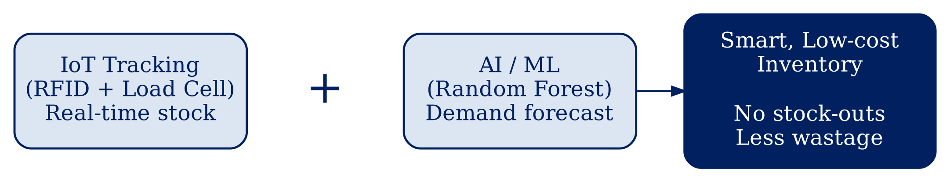
5. Conclusion
The study shows that IoT and AI/ML together turn inventory management from a manual, reactive task into an automatic, data-driven one. RFID and weight sensors give accurate real-time stock, while models like Random Forest forecast demand reliably (93.75% accuracy in [5], MAPE 3.41% in [1]). The same idea works from large supply chains to a single college lab, so a low-cost system that combines tracking with forecasting is a practical and useful project [7], [11].
Fig 2: IoT tracking + AI/ML forecasting = Smart Inventory [5], [7], [9]

Slide 12
6. Project Initiation
The Smart Inventory Management project was initiated to solve the problem of manual stock handling in college departments, laboratories and small stores, where items are tracked in registers, issued without proper records and purchased by guesswork [4], [10].
The project aims to build a low-cost system that records stock automatically using an ESP32 with RFID and load-cell sensors, stores data on a server, forecasts demand using a Random Forest model, and shows live stock on a web dashboard with automatic low-stock alerts [7], [8], [11].

Slide 13
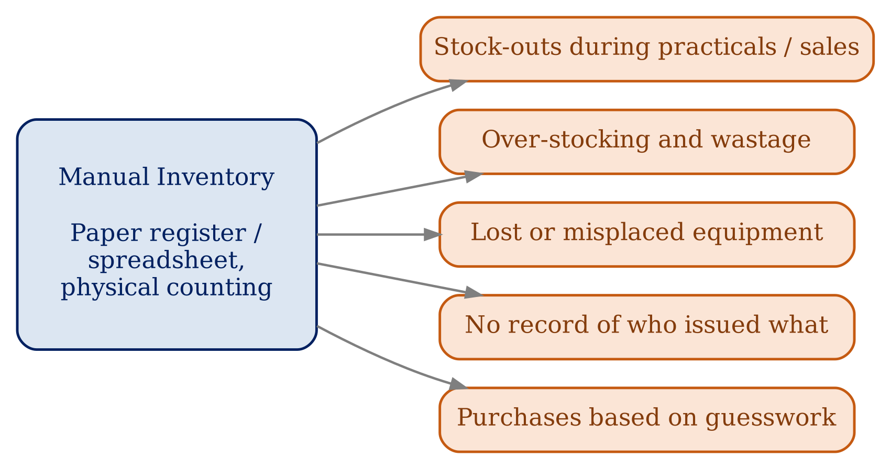
6.1 Description of Problem Statement
Stock in departments, labs and small stores is kept in registers and counted by hand [4].
This leads to shortages, excess purchase, lost items and no usage record [10].
A low-cost system is needed to track stock and predict demand automatically [8], [9].
Fig 3: Problems of manual inventory management [4], [10]

Slide 14
6.2 Scope and Objectives
Objectives
Track issue and return of items automatically using RFID [9].
Measure quantity of bulk items using load-cell sensors [6].
Store all stock movements in a central database [10].
Forecast future demand using a Random Forest model [7].
Send automatic low-stock alerts and reorder suggestions [8].
Show stock, history and forecasts on a web dashboard [8].
Scope
Prototype for a college department, laboratory or small store [11].
Uses ESP32, RFID reader (RC522), load cell (HX711), Flask and MySQL [9], [11].
Tested on a small set of items; can be extended to multiple stores [7].
Helps lab in-charges and owners plan purchases with data [4].

Slide 15
6.3 Stakeholders
Lab In-charge / Store Keeper: Manages stock, issues items and receives low-stock alerts [11].
Students and Staff: Borrow equipment; their issue and return records are kept [11].
Head of Department / Management: Uses reports and forecasts for purchase planning [7].
Small Shop / Business Owners: Can use the same system to avoid stock-outs [4], [8].
Suppliers / Vendors: Receive timely orders based on forecasted demand [1].
Developers and Project Guide: Build, test and evaluate the system.

Slide 16
6.4 Seminar Execution Plan
Current Scenario: How is inventory managed today in departments, labs and shops? [4]
Inventory Challenges: Stock-outs, over-stocking, lost items and manual errors [3], [4].
Existing Approaches: RFID tracking, web-based systems and ML forecasting used separately [7], [9], [10].
Research Gap: Low-cost systems track stock but rarely predict demand [9], [10].
Proposed System: ESP32 + RFID + load cell with Random Forest demand forecasting [7], [11].
Future Impact: Accurate stock, timely purchases and less wastage [1], [3].
Future Work: Mobile app, multi-store support and deep-learning forecasting [7].

Slide 17
6.5 Platform / Equipment / Resources
Hardware Requirements:
ESP32 development board [11]
RFID reader (RC522) with RFID tags / cards [9]
Load cell with HX711 amplifier [6]
Laptop / PC (8 GB RAM or more) and Wi-Fi
Software Requirements:
Operating system: Windows / Linux
Arduino IDE for ESP32 firmware (C/C++) [11]
Python with Flask, scikit-learn and pandas [5]
MySQL database; HTML, CSS, JavaScript dashboard [9], [10]
Visual Studio Code
Other Resources:
Research papers and sample inventory / sales data [1]–[11]
Internet connection for server and alerts

Slide 18
Bibliography
Books
Internet of Things: A Hands-On Approach — Arshdeep Bahga and Vijay Madisetti.
Hands-On Machine Learning with Scikit-Learn, Keras and TensorFlow — Aurélien Géron.
Operations Management — William J. Stevenson.
Inventory Management Explained — David J. Piasecki.
Websites
Espressif ESP32 Documentation — docs.espressif.com
Arduino Documentation — docs.arduino.cc
scikit-learn Documentation — scikit-learn.org
Flask Documentation — flask.palletsprojects.com
MySQL Documentation — dev.mysql.com/doc

Slide 19
References
Research Papers
[1] Yu (2025), Optimizing Supply Chain Logistics with IoT and ML (RBRO-WRF)
[2] Singh & Adhikari (2023), AI and IoT: A Future Perspective on Inventory Management
[3] Singh et al., Inventory Management using Big Data and Internet of Things
[4] Bhatt & Nahar (2025), Smart Retail Inventory Management Using AI-Driven IoT
[5] Kotru & Batra (2024), Optimizing Resource Allocation in IoT for Improved Inventory Management
[6] Chukomin et al. (2023), IoT-based Inventory Management Solution using Smart Bins
[7] Saxena et al. (2025), Smart Inventory Management System using Machine Learning
[8] Kamali et al. (2025), Advanced Inventory Management System Powered by IoT and AI
[9] Bousselmi et al., IoT Application for Smart Inventory Management System Based on RFID
[10] Reddy et al. (2025), Smart Inventory Management System
[11] Bandara et al. (2024), Optimizing Efficiency Using a Low-Cost RFID-Based Inventory Management System
Other Sources
[12] K. Ashton, “That ‘Internet of Things’ Thing,” RFID Journal, 2009
[13] University of Cambridge (IfM), “The Origin of the Internet of Things”

Slide 20
Thank you

